Slide 1
Day1 activity 5

Slide 2
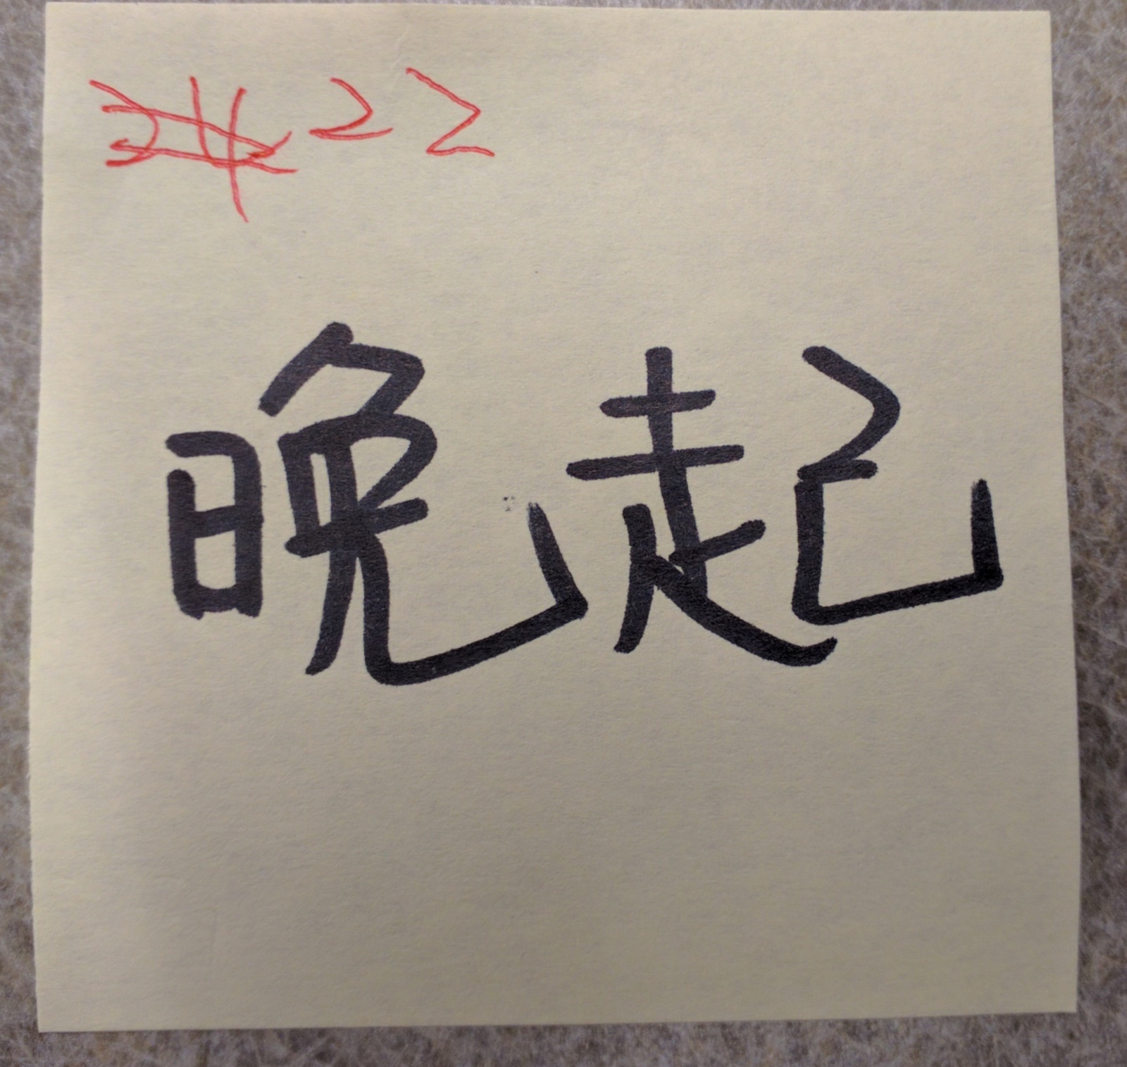
找字
Read out loud the number and the word clearly
Circle the word and write the number heard

Slide 3
功课：健康 Self Assessment
Bring to the classroom tomorrow for class activity.

Slide 4
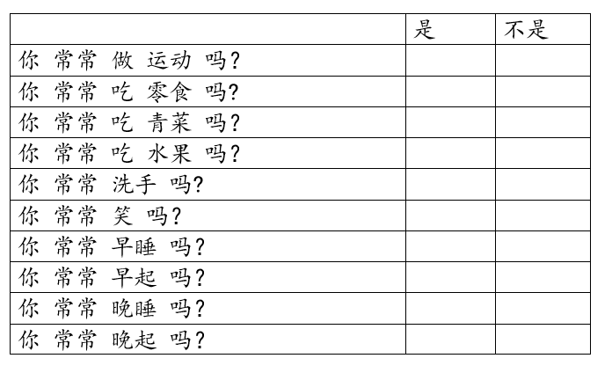
Based on your own situation to make a check mark on yes or no.

